Slide 1

Olympics
By:
NAVEEN KUMAR PAKA KIRIT KUMAR REDDY GAJARI

Slide 2
motivation
The Olympic Games bring a sense of togetherness, inspiration and motivation that no other event can. It is organized once in every four years by different countries. It requires a lot of planning as there are many aspects that to be considered.
So, being a sport lover we decide to construct an ontology for this precious event.

Slide 3
INTRODUCTION
ONTOLOGY : It is a formal representation of the knowledge by set of concepts within the domain and the relationships between those concepts.
The main idea of our ontology is to showcase the different concepts and their relationships in Olympics.

Slide 4
ONTOLOGY components
Classes
Object properties
Data properties
Onto graph

Slide 5
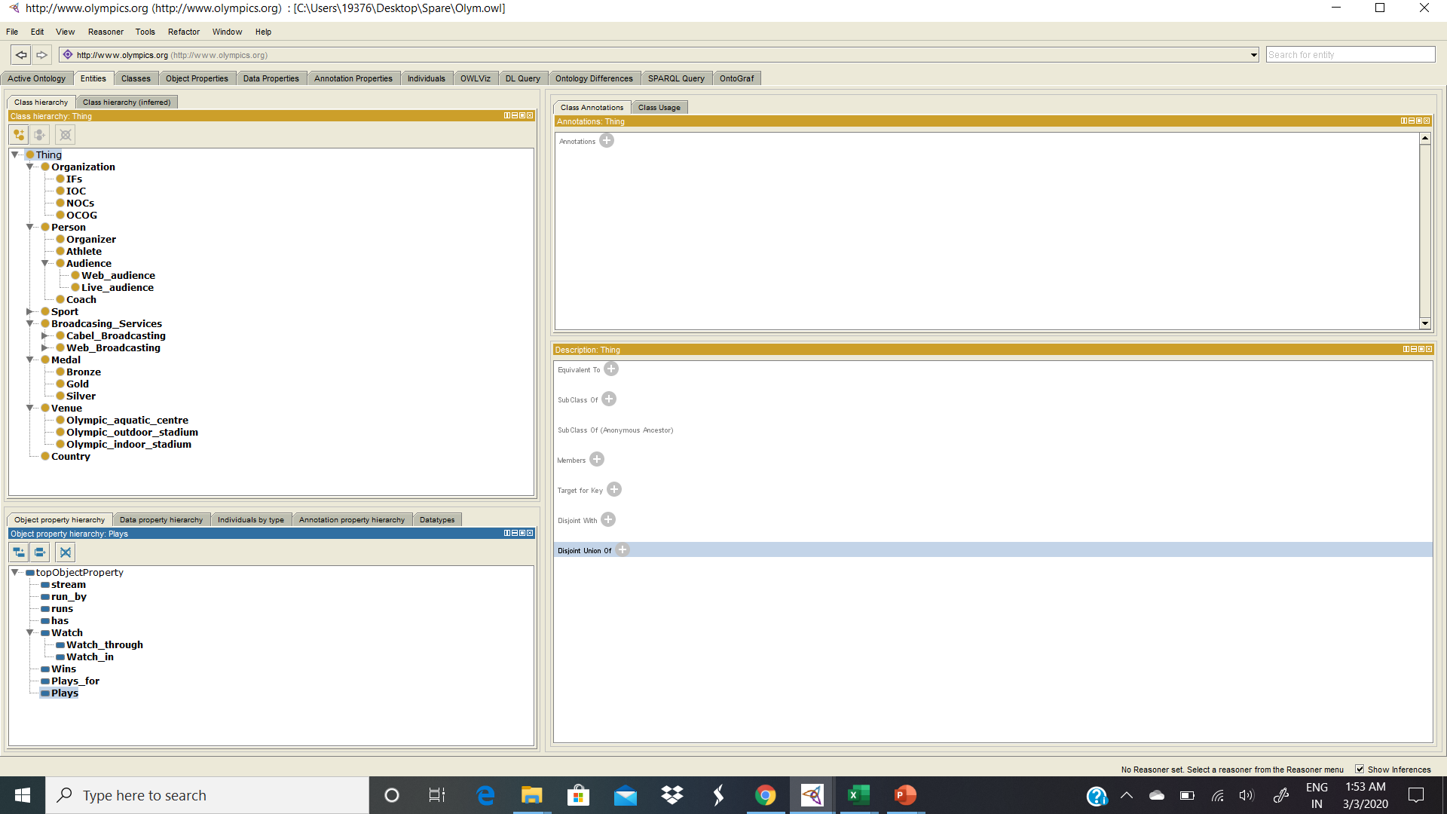
Class Hierarchy

Slide 6
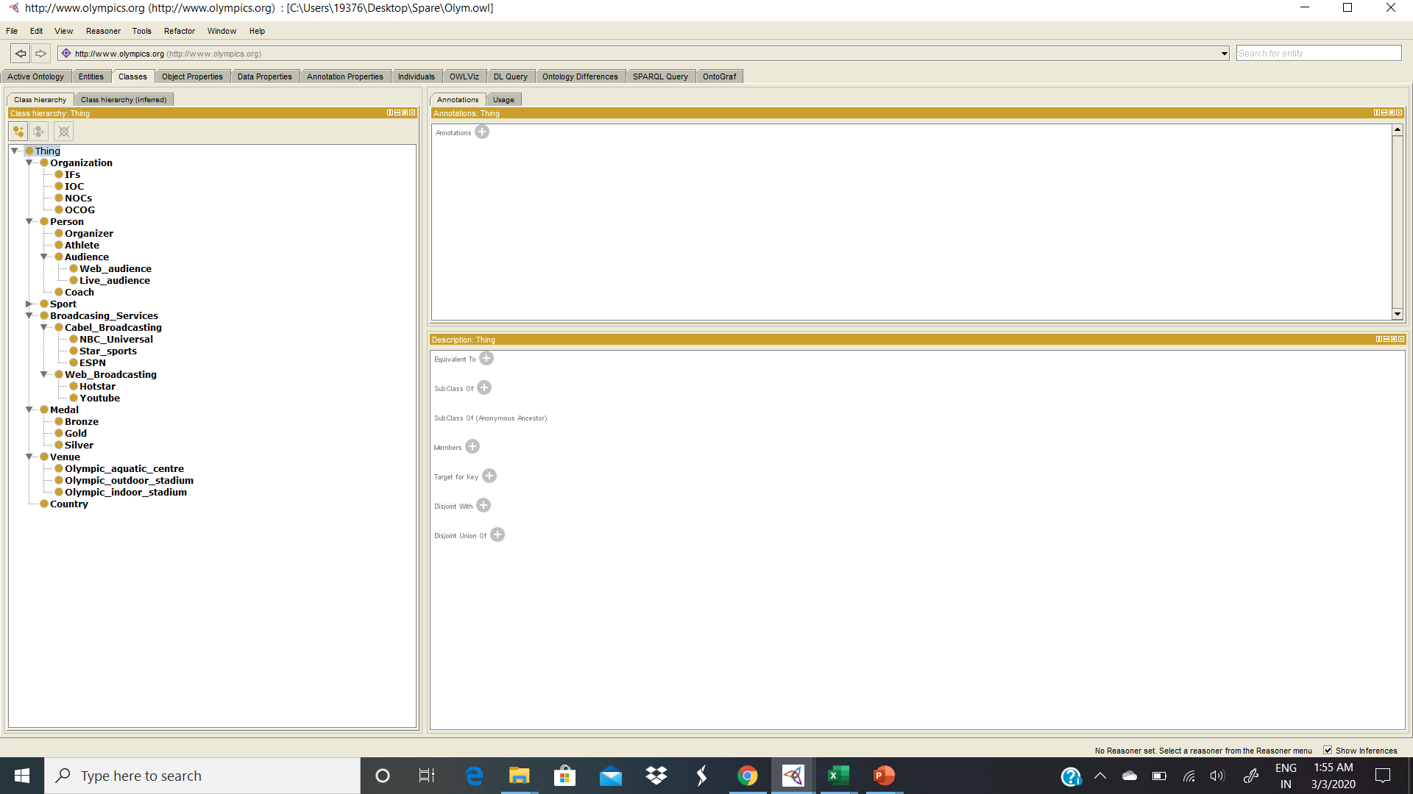

Slide 7
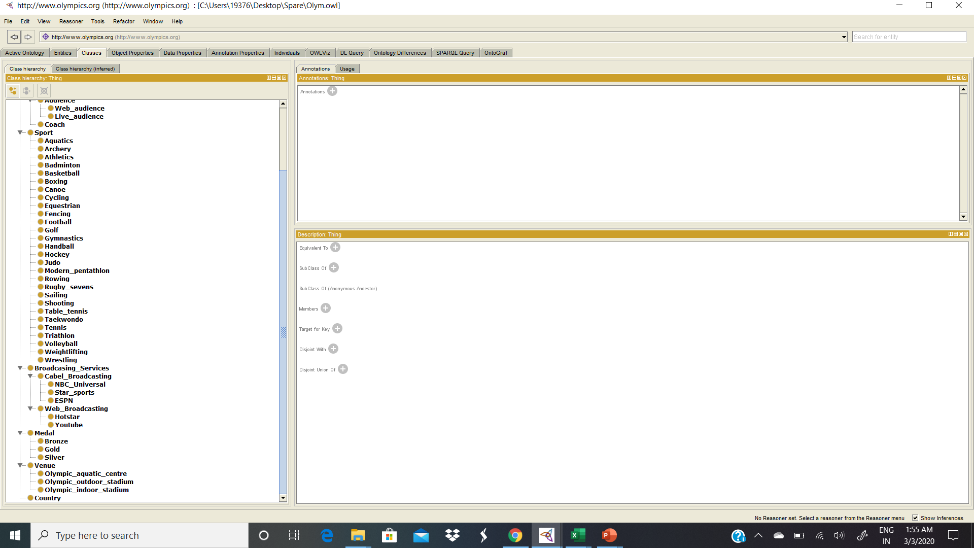

Slide 8
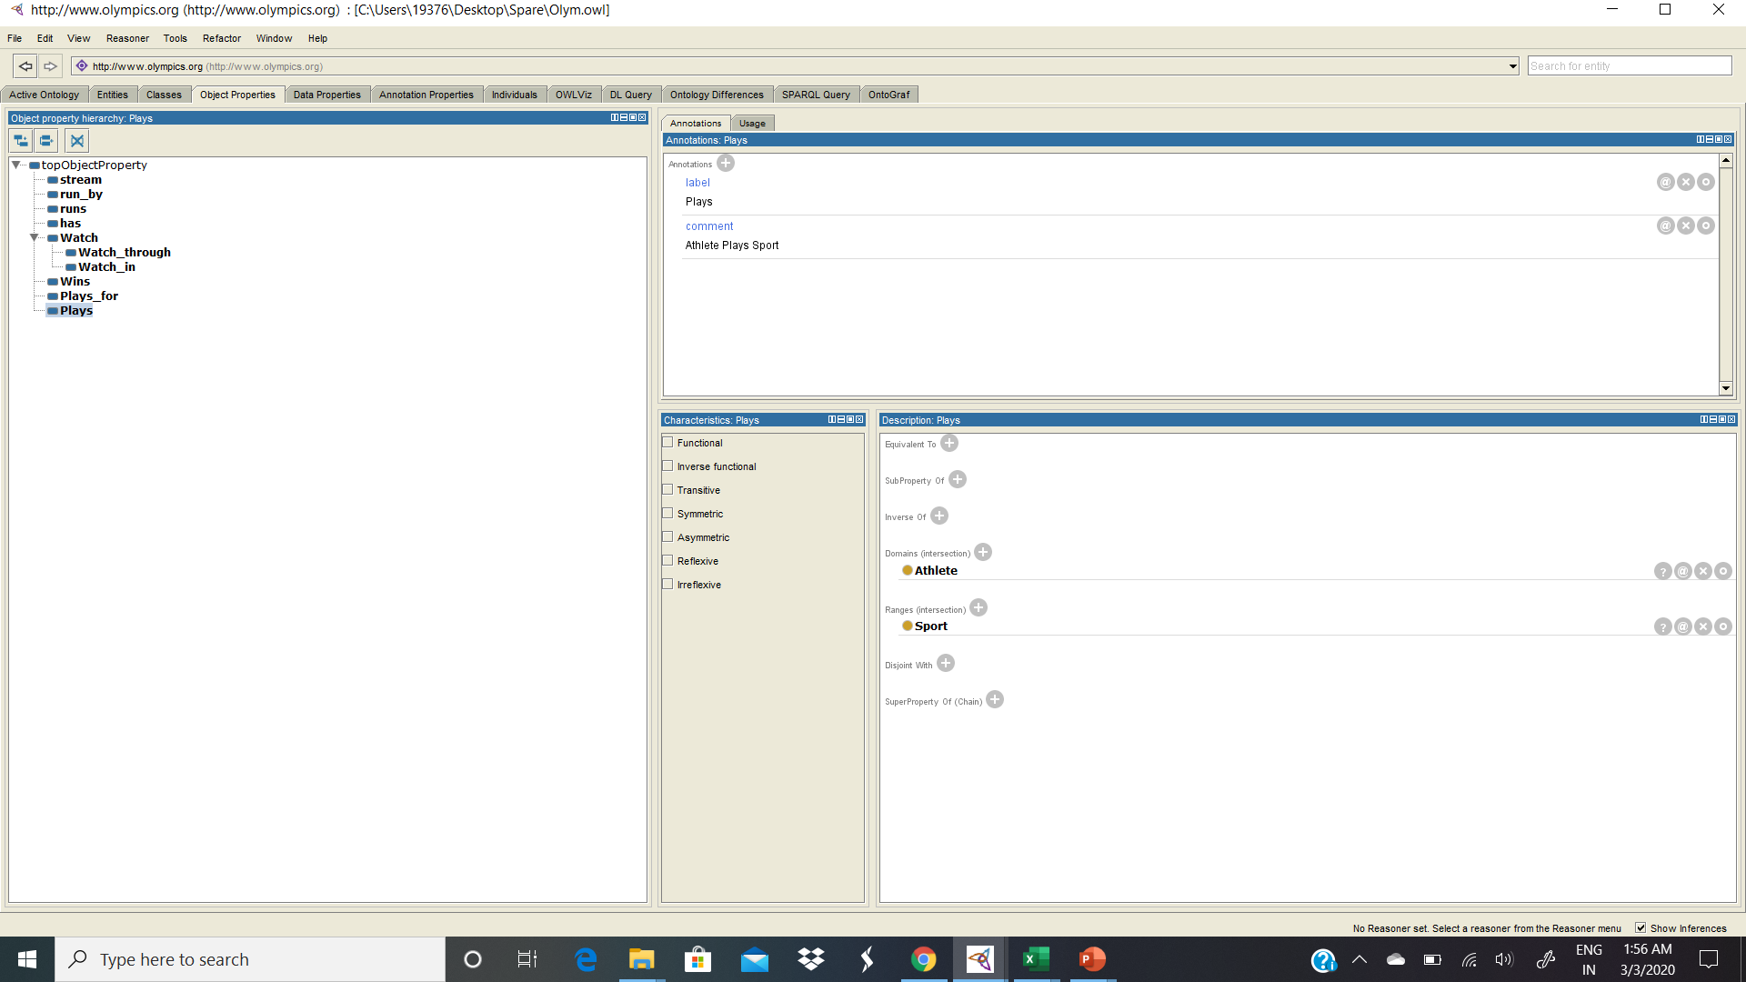
Object properties

Slide 9
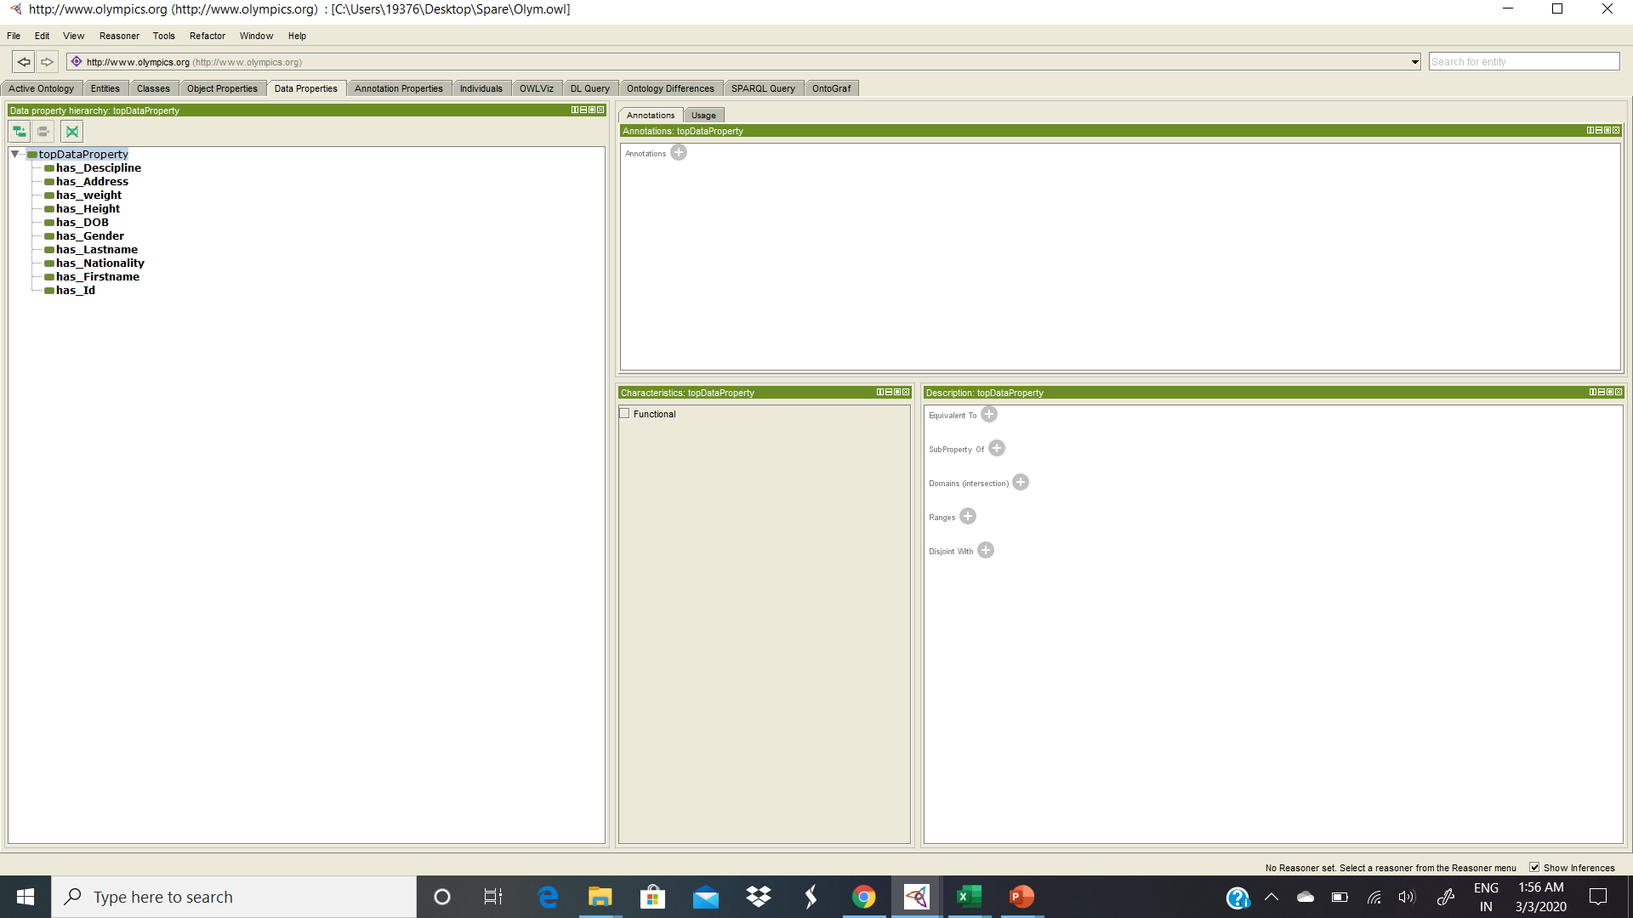
Data properties

Slide 10
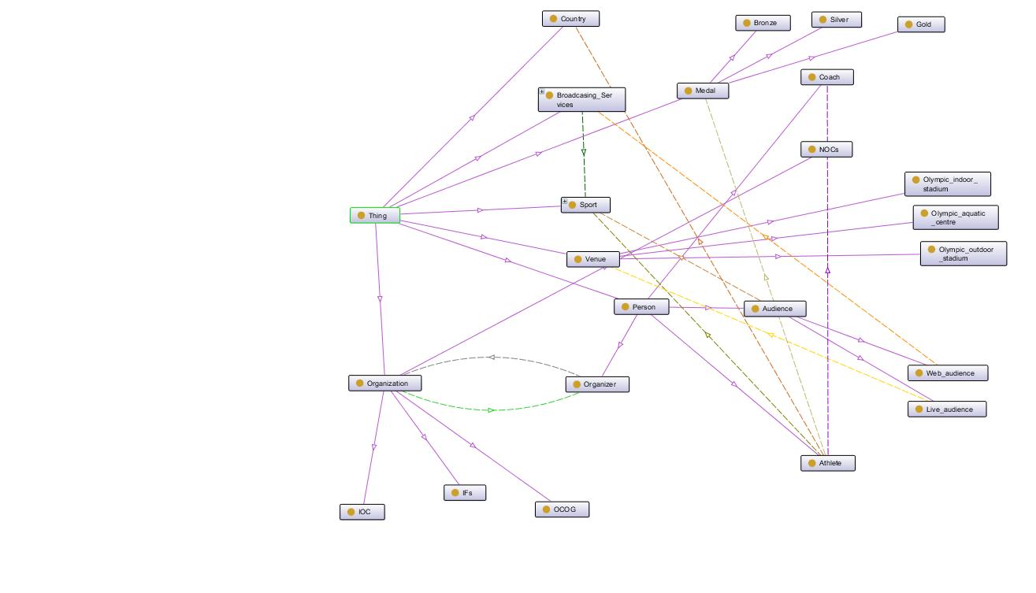
Onto Graph

Slide 11
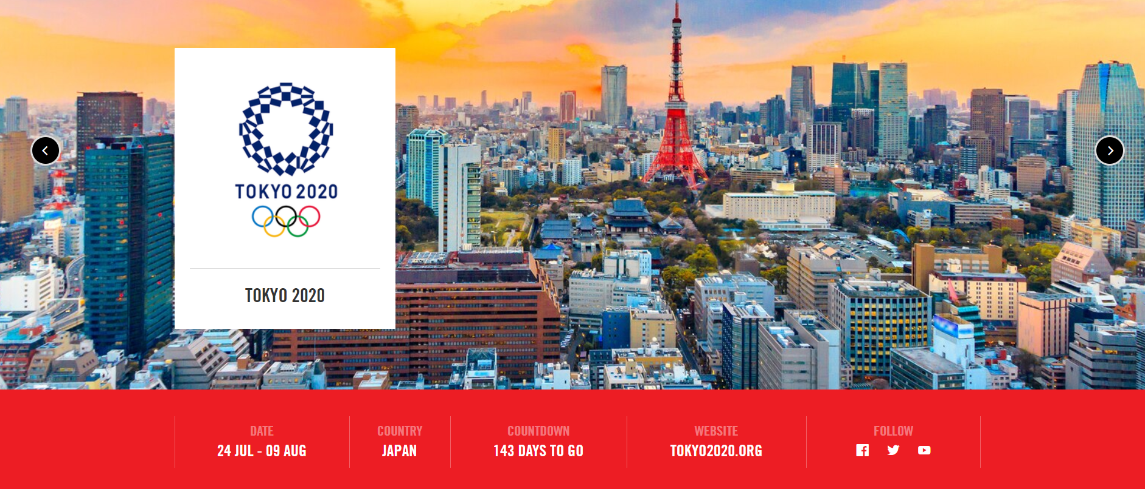
THANK YOU!

